Slide 1

Emotion Detection, Using EEG Signals
Western University

Slide 2

Hello!
I am Tina Gholami
Brain-inspired AI Course
Prof. Yalda Mohsenzade
Computer Science Department

Slide 3
Shapes to explain ideas
1. Introduction
3. Results
5. Discussion
2. Methodology

Slide 4
1. Introduction
EEG, Dataset, Problem to Be Solved

Slide 5
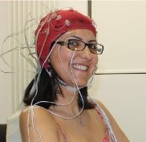
What is EEG?
An electroencephalogram (EEG) is a test (or signals) that detects electrical activity in your brain using small, metal discs (electrodes) attached to your scalp. Your brain cells communicate via electrical impulses (through Ionization) and are active all the time, even when you're asleep. Brain’s Electrical fields can be detected using EEG caps.
DEAP Dataset!
https://www.eecs.qmul.ac.uk/mmv/datasets/deap/readme.html

Slide 6
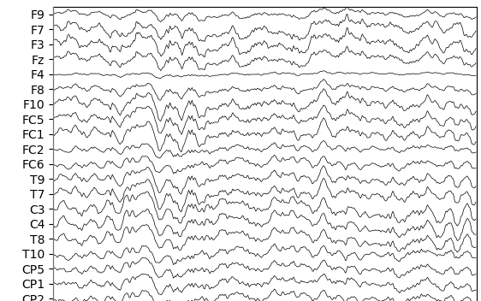
EEG Signals
EEG is a Time-series signal
In order to analyze it, we should incorporate methods for time-series forcasting and preprocessing.
Sliding Window Method!

Slide 7
Problem to Be Solved
DEAP dataset: 32 participants, 40 music videos, rate based on 4 labels “valence”, “Arousal”, “Dominance”, “Liking”, continuous values 1-9 [Reference 1]
Classify videos for each person in order to detect their emotion through the 4 target variables
EEG datasets are highly noise and complex! So, it is hard to achieve a decent accuracy. So, we need powerful preprocessing techniques.
https://www.eecs.qmul.ac.uk/mmv/datasets/deap/readme.html

Slide 8
2. Methodology
Preprocessing Techniques, Learning Algorithm

Slide 9
Preprocessing Techniques
The EEG data should become as clean as possible! So, we can use filtering, FFT, and Wavelet transformation (Popular in both Matlab and Python) -> applied on the DEAP dataset -> but still, there is no limit to preprocessing step!
In my code, person 1 is chosen to be analyzed
Sliding Window Technique: Select fractions of the time-series dataset in order to maintain its “time-dependency” for the CNN model -> an increase in the data at hand -> There are many different ways to implement windowing

Slide 10
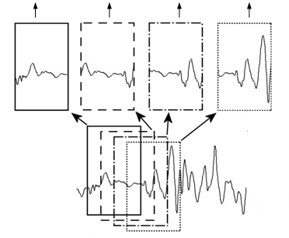
Windowing
Window-size = 128
Stride = 32
Each time-series data = 8064 samples (sampled by 256HZ from 1-minute music videos)

Slide 11
The Process
Step 01
Step 03
Step 05
Step 07
Extract data and labels of person number 1
Check for missing values
Apply Windowing: overlap windows
Standardization on the data and
One-hot-encoding on the labels
Splitting the data into train and test set
Person 1 (80/20)
32 music as train
8 music as test
Convert continuous targets to categorical for classification
Time-series dataset reshape (times in the rows, not in the columns)
Train the CNN model
Step 02
Step 04
Step 06
Step 08

Slide 12
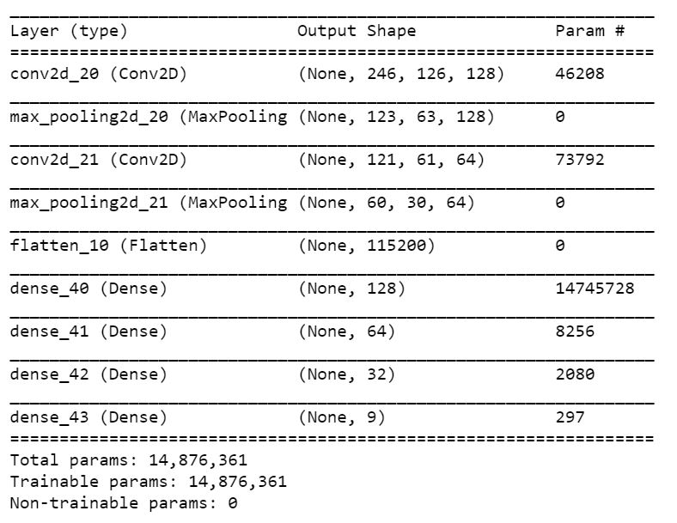
The Model Architecture
Softmax
Categorical cross Entropy
Adam
Detect “Valence” for person 1
Early Stopping
50 Epochs
64 Batches

Slide 13
3. Results
Accuracy, Validation Loss

Slide 14
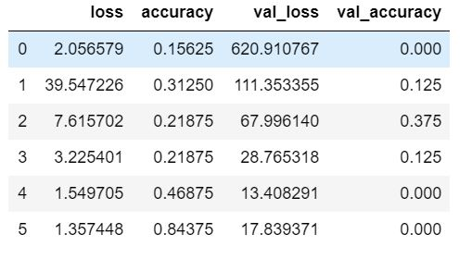
Results
No overfitting -> loss is continuously decreasing
Still in process to improve accuracy on the validation set -> one of the reasons might be because test set is too small

Slide 15
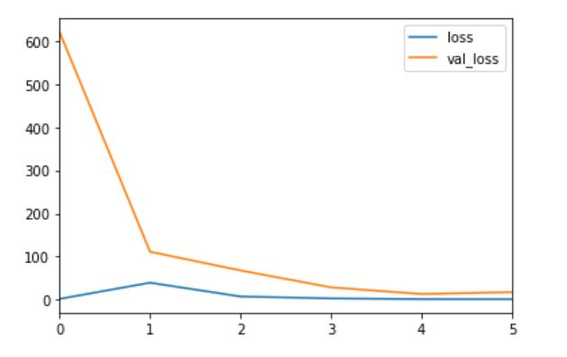
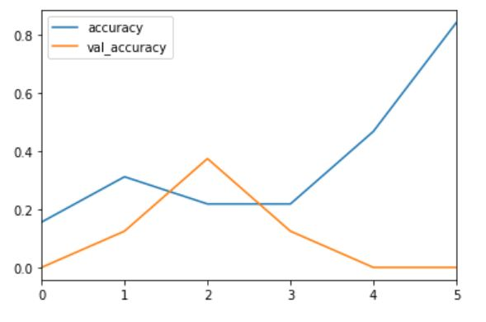
Results
It is not uncommon to have oscillating accuracy on the validation set for time-series data, especially EEG

Slide 16
4. Discussion
Suggestions, Similar Works

Slide 17
Discussion
Suggestions:
Similar Works
Analyze other people involved in this test and calculate the average mean over all people, instead of only person 1
Apply modification to the Windowing method
Change Loss function to resolve low validation accuracy
In [Reference 2], DNNs and CNNs are implemented with optimizations in the Windowing and also activation function “TanHyperbolic”!
In [Reference 3], sliding window is applied in a way to increase the features along the time axis

Slide 18
References:
DEAP: A Database for Emotion Analysis using Physiological Signals; Sander Koelstra, Christian M¨uhl, Mohammad Soleyman, Jong-Seok Lee, Ashkan Yazdani, Touradj Ebrahimi, Thierry Pun, Anton Nijholt, Ioannis Patras; IEEE; 2019
Using Deep and Convolutional Neural Networks for Accurate Emotion Classification on DEAP Dataset; Samarth Tripathi, Shrinivas Acharya, Ranti Dev Sharma, Sudhanshi Mittal, Samit Bhattacharya; AAAI Conference; 2017
Neural Networks for Human Activity Recognition With Wearable Sensors: Leave-One-Subject-Out Cross-Validation for Model Selection; Davoud Gholamiangonabadi, Katarina Grolinger, Nikita Kiselov; IEEE; 2020

Slide 19
Thanks!
Any questions?
You can find me at: tgholam2@uwo.ca

